Slide 1
BHAVANI ENTERPRISES
Manufacturers of
Water Dispensers | Water Purifier | Water Cooler

Slide 2
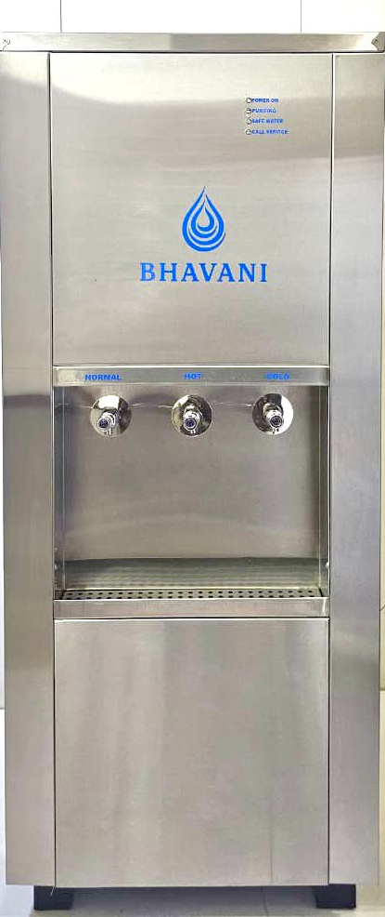

Slide 3
Custom-Built to Match Your Requirement
Bhavani Water Purifiers are available from 24Ltrs storage to 120L Storage.
Designed for continuous, high-usage environments
Supports multiple outlets for uninterrupted supply
Built with industrial-grade components for reliability

Slide 4
WHY BUY FROM US
Manufacturer – direct control on quality & delivery
Custom-built solutions based on actual site requirement
Industrial-grade design for long service life
Simple service & spare availability for low downtime

Slide 5
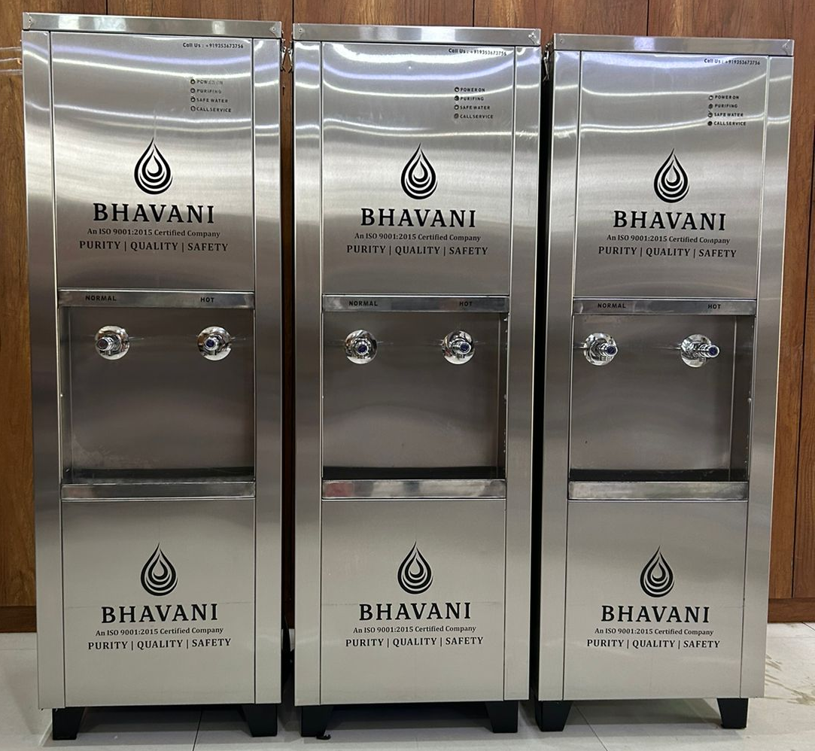

Slide 6
PROCESS & QUALITY CONTROL
Structured manufacturing process from fabrication to assembly
Quality checks at multiple stages of production
Final inspection before dispatch
Consistent build quality across all units

Slide 7
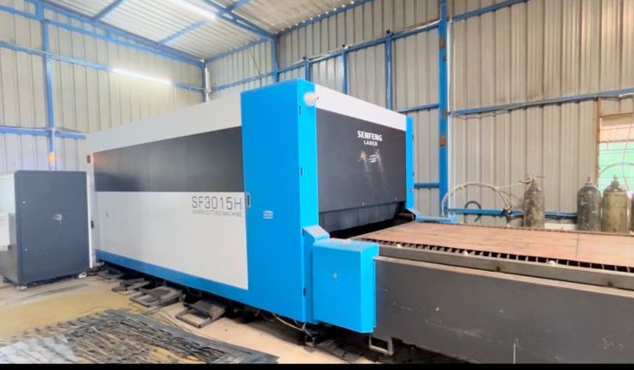
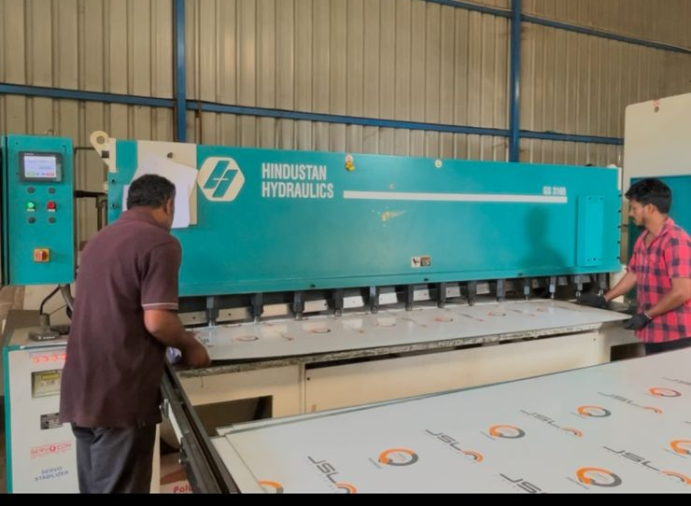
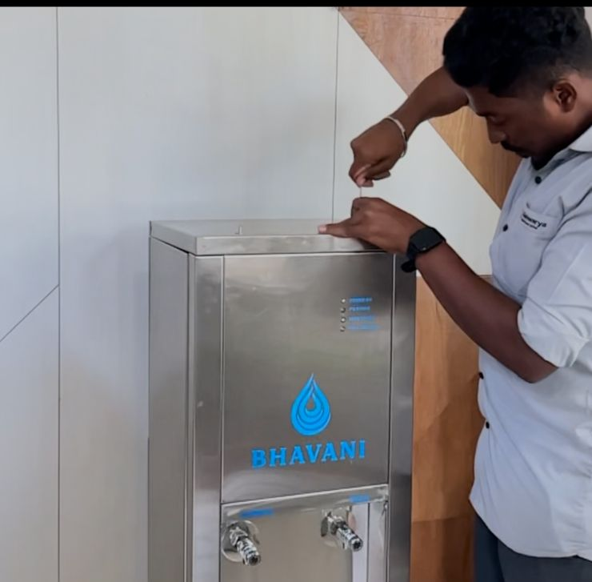
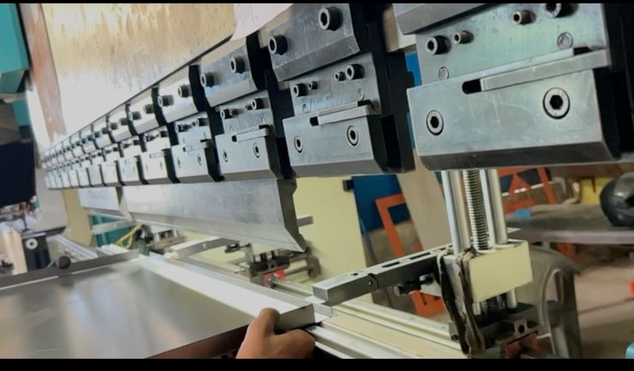

Slide 8
SERVICE & SUPPORT
Easy installation with clear site requirements
Designed for quick servicing & part replacement
Support through local technicians / partners
Low maintenance cost over long-term usage

Slide 9
WARRANTY & ASSURANCE
1 Year manufacturing warranty
Each unit tested before dispatch
Designed for long operational life
Reliable performance under continuous usage

Slide 10
Contact
BHAVANI ENTERPRISES
2553,Purvika Residency,2nd Stage
Near Yellamma Temple,Hebbal
Mysure, 570016, Ph:9353673756
Email:sales@bhavanienterprises.co / bhavanienterpriseskrp@gmail.com
GSTIN/UIN:29BYXPB2488P1ZA, State: 29-Karnataka

